Slide 1

INL/CON-19-55780
Optimization
RAVEN workshop

Slide 2
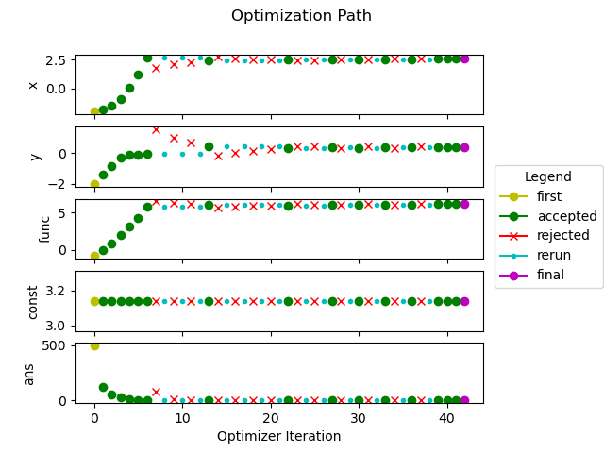
Outline
Optimizing in RAVEN
Gradient Descent
Genetic Algorithms
Parameter Fitting

Slide 3
Optimizing in RAVEN
Premature optimization is the root of all evil. – Donald Knuth, 1974

Slide 4
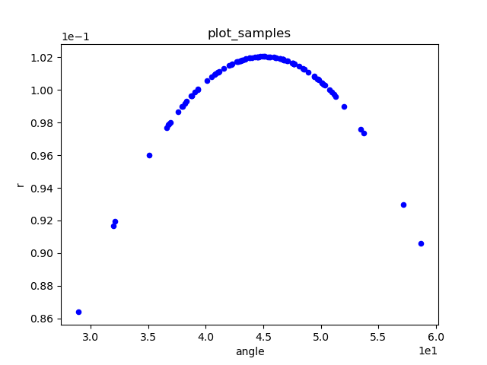
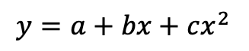
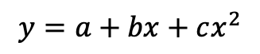
Why RAVEN?
Many tools exist for numerical optimization
Scipy, PuLP, Pyomo, etc
Requirement: call-back or algebraic functions (“white box”)
Good optimization is very hard on black boxes
White Box
Black Box
$$y=a+bx+cx^{2}$$
$$y=a+bx+cx^{2}$$
Inputs
Response
Inputs
Response

Slide 5

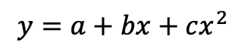
RAVEN understands black boxes
System codes aren’t usually algebraic
Neutronics, thermal hydraulics, structural
Complex, coupled systems
RAVEN samples codes through interfaces
Approximate derivatives
Explore response surfaces
Black box optimization slower than algebraic
Sometimes that’s the best we can get
Black Box
$$y=a+bx+cx^{2}$$
Inputs
Response

Slide 6
Optimization expectations
Optimization requires many iterative searches
600 to 1000 for a reasonable convergence
Each iteration may require several model runs
Optimizer parameters dictate run
Adjusting parameters can dramatically change path
Rarely know parameters before trying, checking
Sometimes setting up a solve is an iterative process

Slide 7


Optimization Algorithms
Gradient Descent
Gradient approximations
Step size adjustments
Rolling a ball down a hill
Genetic Algorithms
Evolving populations
Heuristics
Fitness and survival

Slide 8
Gradient Descent
Rolling stones gather no moss.

Slide 9
Gradient Descent
Start somewhere
Approximate local gradient
Choose direction, step size
Take a step
If improved, go to (2)
Otherwise, return to previous spot
Then go to (2)
Continue to convergence
Tuning Parameters
Starting location, step size
Algorithm for gradient approximation
Step shrink, growth factors
Convergence criteria

Slide 10

Gradient Descent
Strengths
Great at navigating concave surfaces
Can quickly traverse response space
Few runs for significant progress
Weaknesses
Falls into local minima
Difficulty finding promising regions
Slow for high convergence

Slide 11
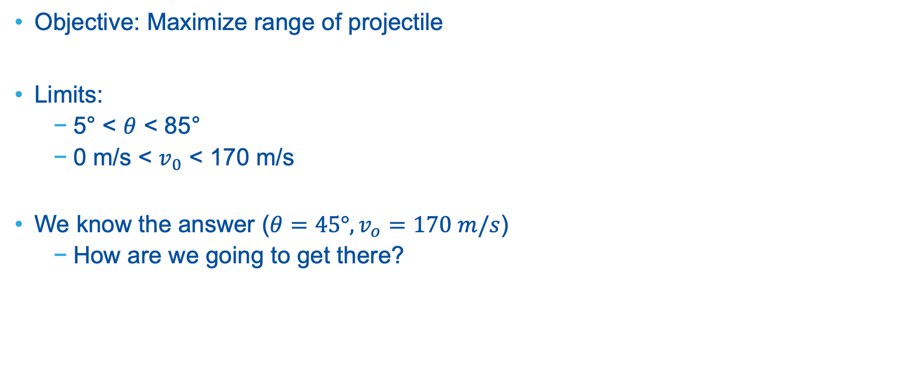
Now in
Objective: Maximize range of projectile
Limits:
5° < $θ$ < 85°
0 m/s < $v_{0}$ < 170 m/s
We know the answer ($θ=45°, v_{o}=170 m/s$)
How are we going to get there?

Slide 12
Exercise 1: UQ to Optimization
Adaptive Sampling is like Forward Sampling, but not.

Slide 13
Basic RAVEN Optimization
Open the file
Let’s look at the file
MultiRun
Optimizer
samplerInit
gradient
stepSize
convergence
acceptance
> cd raven/doc/workshop/optimizer/Inputs
> open 1_grad_desc.xml

Slide 14
Run the case
Open the file
Lots of output to screen!
Files created
> cd raven/doc/workshop/optimizer/Inputs
> ~/projects/raven/raven_framework 1_grad_desc.xml
> cd raven/doc/workshop/optimizer/Inputs
> ls GradDesc
opt_search.csv path.png
opt_search.xml
opt_search_0.csv

Slide 15
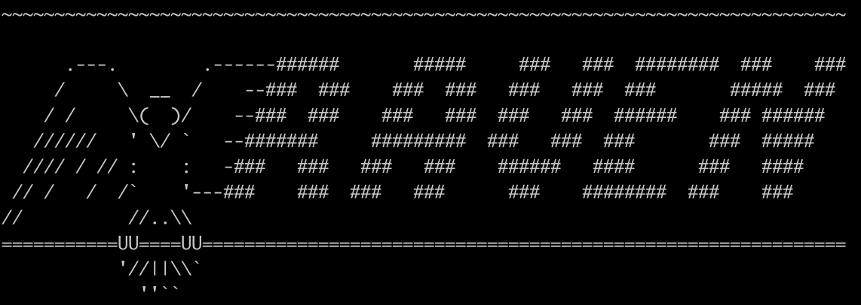
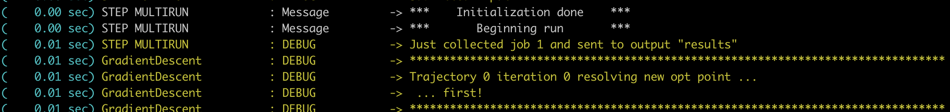
Looking at Results: Screen Output
First point is always accepted
You have to start somewhere!

Slide 16
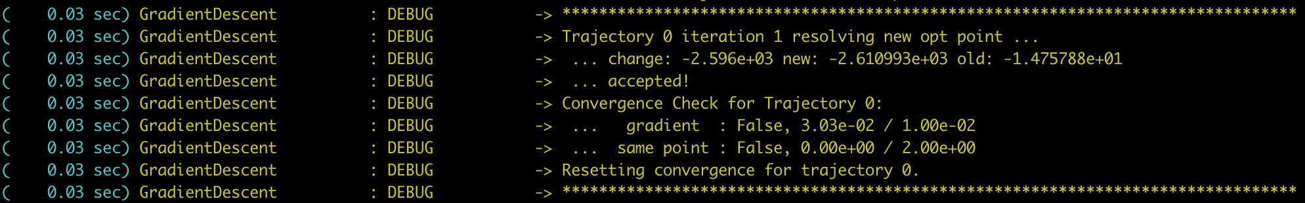
Looking at Results: Screen Output
Accepting a new opt point
New point is better than the old one!
Status of convergence criteria

Slide 17
Looking at Results: Screen Output
Accepting a new opt point
New point is worse than the old one!
Triggers a return to the previous opt point, step size cut, and rerun gradient

Slide 18
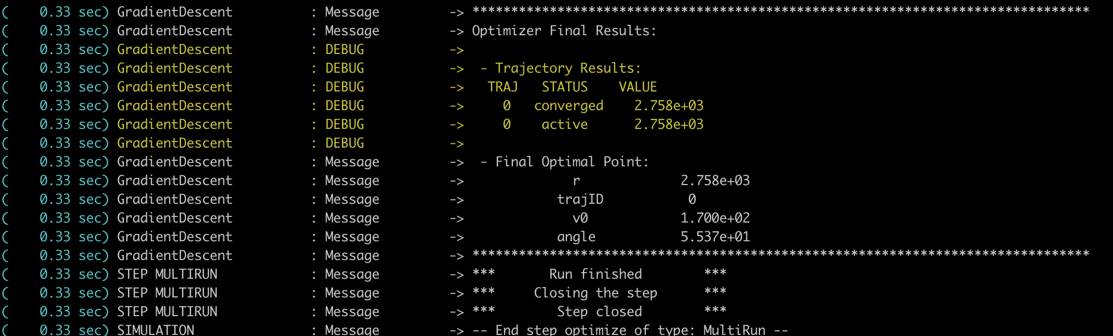
Looking at Results: Screen Output
Final Results

Slide 19
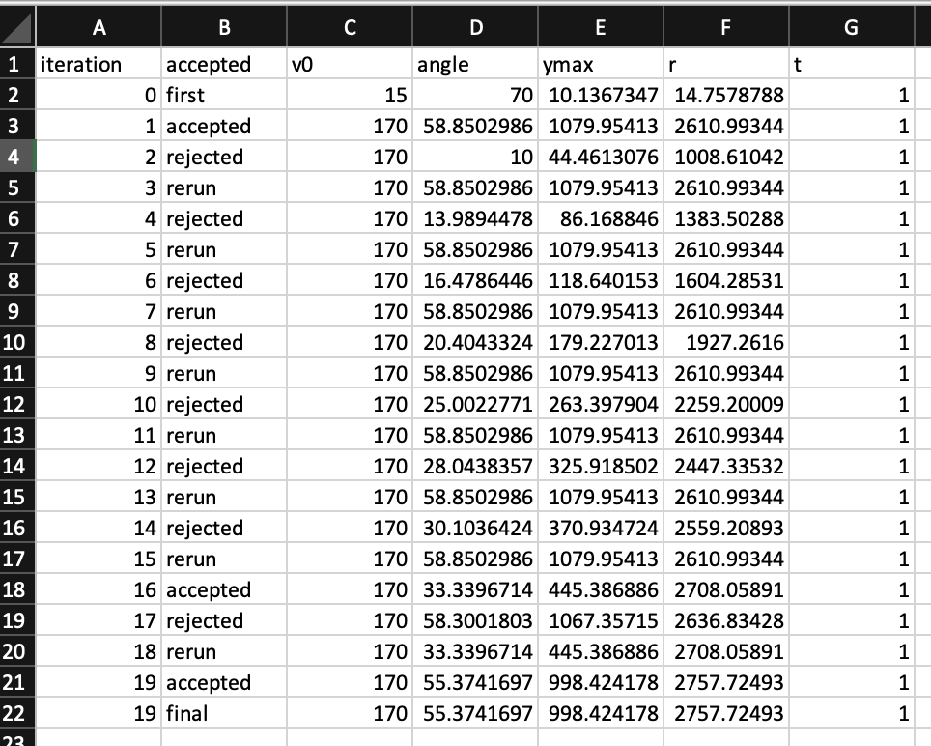
Looking at Results: CSV
> GradDesc/opt_search_0.csv
Status of Iteration
Variable Values

Slide 20
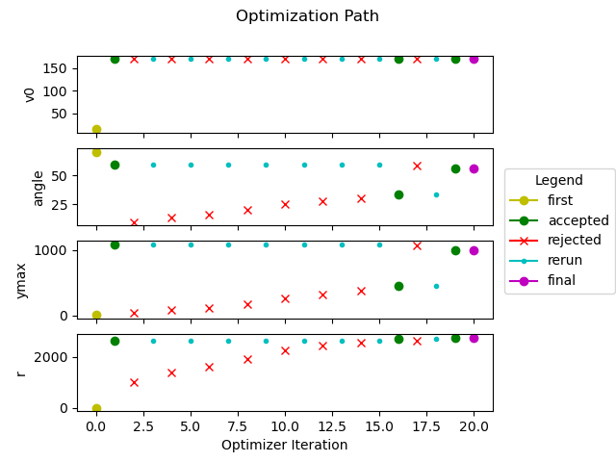
Looking at Results: Plot
> GradDesc/opt_search_0.csv
Variable Values
Status of Iteration

Slide 21
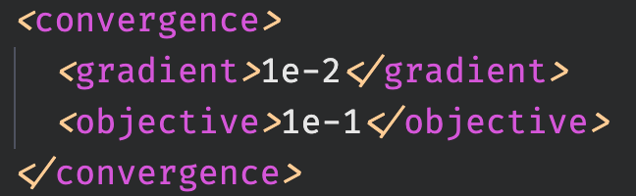
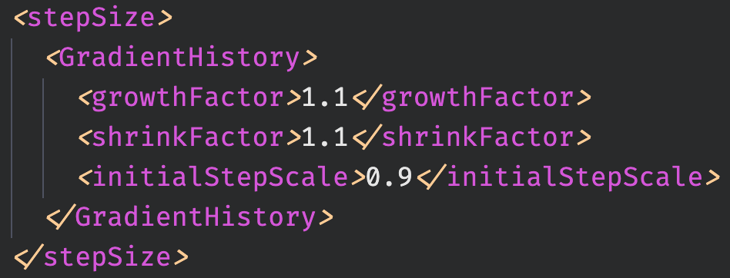
Exercise: Knobs and Levers
> 1_grad_desc.xml
Lots of ways to modify how the optimizer behaves
Now your turn: optimize the optimization path!

Slide 22
Exercise 2: Constraints
Wait, no, not like that!

Slide 23

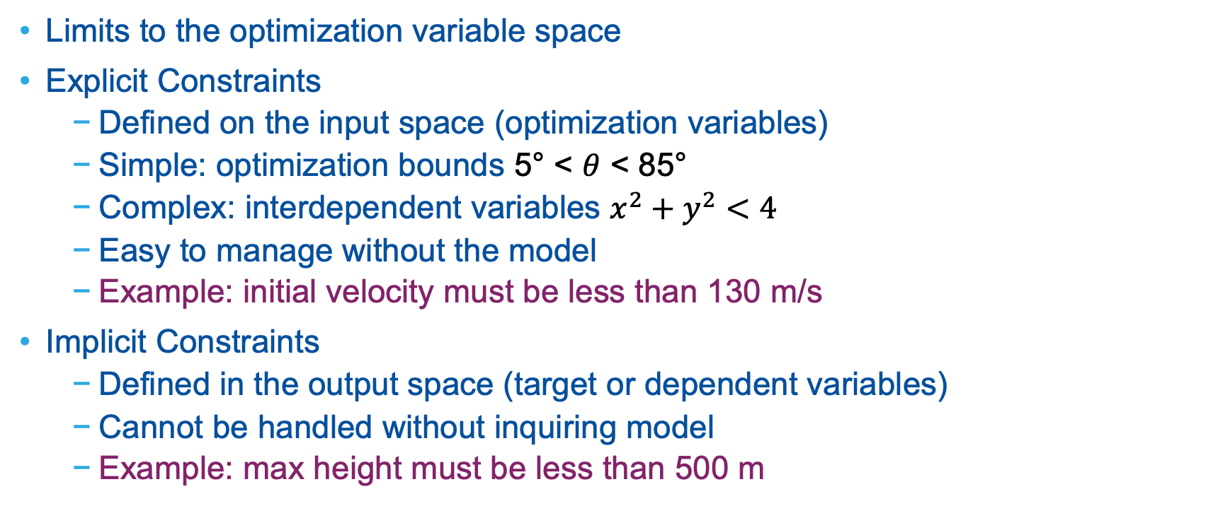
Constraints in Optimization
Limits to the optimization variable space
Explicit Constraints
Defined on the input space (optimization variables)
Simple: optimization bounds 5° < $θ$ < 85°
Complex: interdependent variables $x^{2}+y^{2}<4$
Easy to manage without the model
Example: initial velocity must be less than 130 m/s
Implicit Constraints
Defined in the output space (target or dependent variables)
Cannot be handled without inquiring model
Example: max height must be less than 500 m

Slide 24
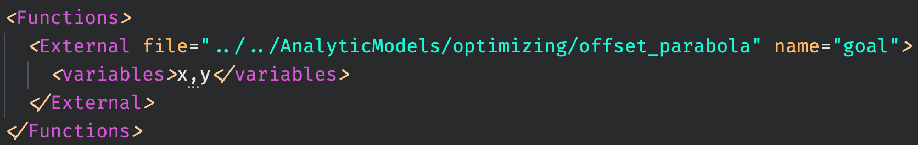
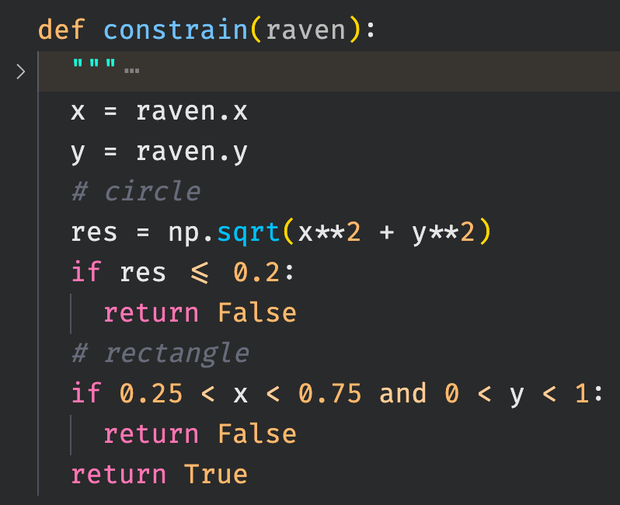
Explicit Constraints in RAVEN
External Functions
Custom Python methods
See an example in
raven/tests/framework/Optimizers/GradientDescent/constrain_function.py

Slide 25
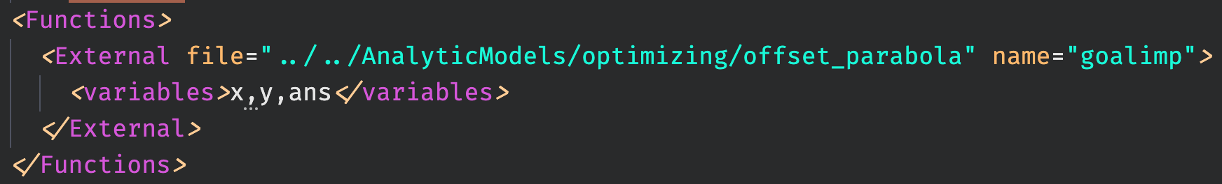
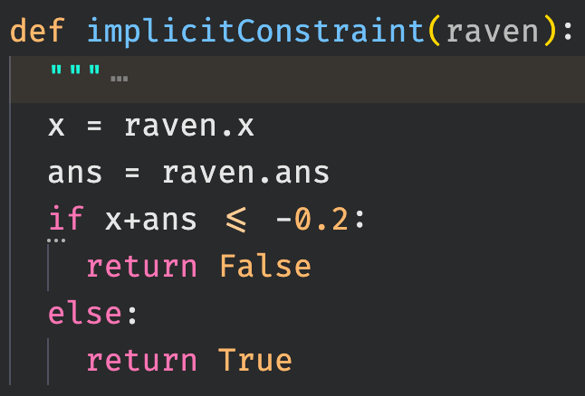
Implicit Constraints in RAVEN
External Functions
Custom Python methods
See an example in
raven/tests/framework/Optimizers/GradientDescent/constrain_function.py

Slide 26

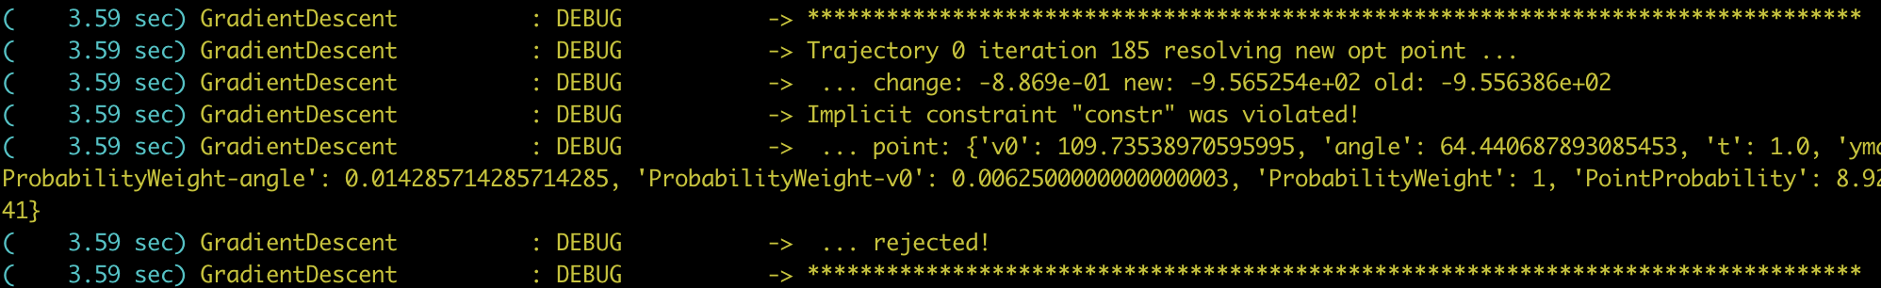
Exercise 2: Constraints
Add constraints to Projectile optimization
Implicit: Max height < 250 m

Slide 27
Exercise 2: Constraints
Add constraints to Projectile optimization
Implicit: Max height < 250 m
My Solution
Initial v0: 165
Initial angle: 20
Convergence tolerance: 1e-8
Step growth = shrink = 1.1
Initial Step Scale: 0.1
Solution:

